Slide 1
Scheduling in Windows
Operating systems (vimia219)
Zoltan Micskei
http://mit.bme.hu/~micskeiz

Slide 2
Copyright Notice
These materials are part of the Windows Operating System Internals Curriculum Development Kit, developed by David A. Solomon and Mark E. Russinovich with Andreas Polze
Microsoft has licensed these materials from David Solomon Expert Seminars, Inc. for distribution to academic organizations solely for use in academic environments (and not for commercial use)
http://www.academicresourcecenter.net/curriculum/pfv.aspx?ID=6191
© 2000-2005 David A. Solomon and Mark Russinovich
Notes:
This slide show uses materials from the Windows Operating System Internals Curriculum Development Kit

Slide 3
Basic concepts
Process
1
1..n
Thread
Running instance of a program
Unit of scheduling
Memory
CPU
Address space
Resources
Security token
Execution environment
Notes:
--From the Windows Operating System Internals Curriculum Development Kit
“Although programs and processes appear similar on the surface, they are fundamentally different. A program is a static sequence of instructions, whereas a process is a container for a set of resources used when executing the instance of the program. At the highest level of abstraction, a Windows process comprises the following:
A private virtual address space, which is a set of virtual memory addresses that the process can use
An executable program, which defines initial code and data and is mapped into the process’s virtual address space
A list of open handles to various system resources, such as semaphores, communication ports, and files, that are accessible to all threads in the process
A security context called an access token that identifies the user, security groups, and privileges associated with the process
A unique identifier called a process ID (internally called a client ID)
At least one thread of execution”
“A thread is the entity within a process that Windows schedules for execution. Without it, the process’s program can’t run. Although threads have their own execution context, every thread within a process shares the process’s virtual address space (in addition to the rest of the resources belonging to the process), meaning that all the threads in a process can write to and read from each other’s memory. Threads cannot accidentally reference the address space of another process, however, unless the other process makes available part of its private address space as a shared memory section (called a file mapping object in the Windows API) or unless one process has the right to open another process to use cross-process memory functions such as ReadProcessMemory and WriteProcessMemory.”

Slide 4
Principles of Windows scheduling
Preemptive scheduler (both kernel and user!)
32 priority levels
(One of the) Thread with the highest priority runs
Round robin between threads with same priority
Threads run for a fixed time (quantum)
No central scheduler, scheduling is driven by events
Priority of threads can change runtime

Slide 5
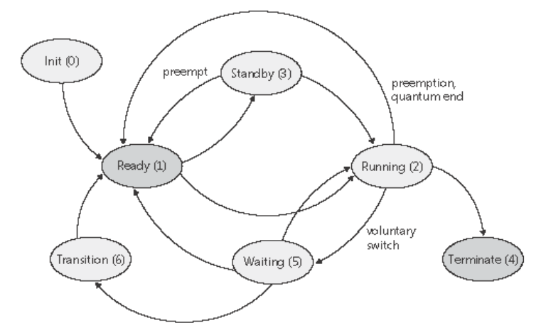
Scheduling
Notes:
Ready A thread in the ready state is waiting to execute. When looking for a thread to execute, the dispatcher considers only the pool of threads in the ready state.
Standby A thread in the standby state has been selected to run next on a particular processor. When the correct conditions exist, the dispatcher performs a context switch to this thread. Only one thread can be in the standby state for each processor on the system. Note that a thread can be preempted out of the standby state before it ever executes (if, for example, a higher priority thread becomes runnable before the standby thread begins execution).
Running Once the dispatcher performs a context switch to a thread, the thread enters the running state and executes. The thread's execution continues until its quantum ends (and another thread at the same priority is ready to run), it is preempted by a higher priority thread, it terminates, it yields execution, or it voluntarily enters the wait state.
Waiting A thread can enter the wait state in several ways: a thread can voluntarily wait for an object to synchronize its execution, the operating system can wait on the thread's behalf (such as to resolve a paging I/O), or an environment subsystem can direct the thread to suspend itself. When the thread's wait ends, depending on the priority, the thread either begins running immediately or is moved back to the ready state.
Transition A thread enters the transition state if it is ready for execution but its kernel stack is paged out of memory. Once its kernel stack is brought back into memory, the thread enters the ready state.
Terminated When a thread finishes executing, it enters the terminated state. Once the thread is terminated, the executive thread block (the data structure in nonpaged pool that describes the thread) might or might not be deallocated. (The object manager sets policy regarding when to delete the object.)
Initialized This state is used internally while a thread is being created.

Slide 6
Priority levels (kernel)
NOT hard/soft real-time, just priority is constant
31
16
16 “real-time”
Priority of the thread can be changed
15
1
15 dynamic
0
i
If nothing else to run, counts spare cycles
Idle

Slide 7
Priority levels (Windows API, GUI)
Realtime
High
Above Normal
Normal
Below Normal
Idle
Value of priority
Name of priority levels
31
16
15
1

Slide 8
Windows API vs. kernel names
Threads: 7 different relative priority
Mapping:
 |  | Win32 process priority levels
 |  | Realtime | High | Above Normal | Normal | Below Normal | Idle
Win32 thread priorities | Time-critical | 31 | 15 | 15 | 15 | 15 | 15
 | Highest | 26 | 15 | 12 | 10 | 8 | 6
 | Above-normal | 25 | 14 | 11 | 9 | 7 | 5
 | Normal | 24 | 13 | 10 | 8 | 6 | 4
 | Below-normal | 23 | 12 | 9 | 7 | 5 | 3
 | Lowest | 22 | 11 | 8 | 6 | 4 | 2
 | Idle | 16 | 1 | 1 | 1 | 1 | 1

Slide 9
I/O priority
Since Vista
5 different I/O priority for requests, e.g.
Critical: Dirty page writer
Low: Desktop search indexer
I/O bandwidth allocation

Slide 10
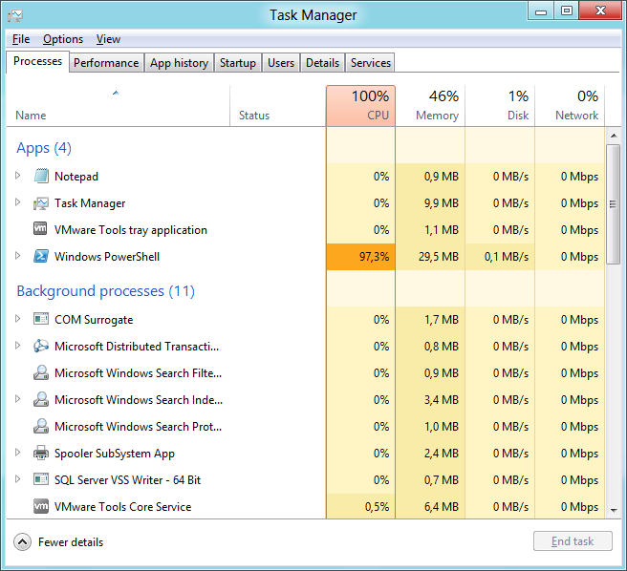
Windows 8 task manager
„Heat map”
Redesign based on telemetry
Groupping
„Friendly name”
Notes:
See> MSDN Building Windows 8 Blog, „The Windows 8 Task Manager”, October 13, 2011. URL: http://blogs.msdn.com/b/b8/archive/2011/10/13/the-windows-8-task-manager.aspx

Slide 11
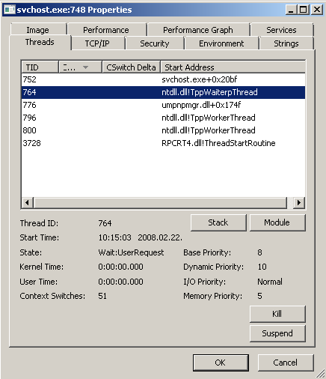
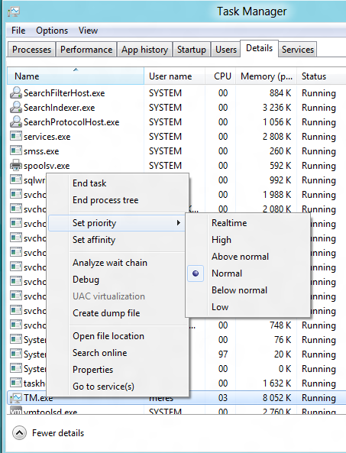
Changing priority
Task manager

Slide 12
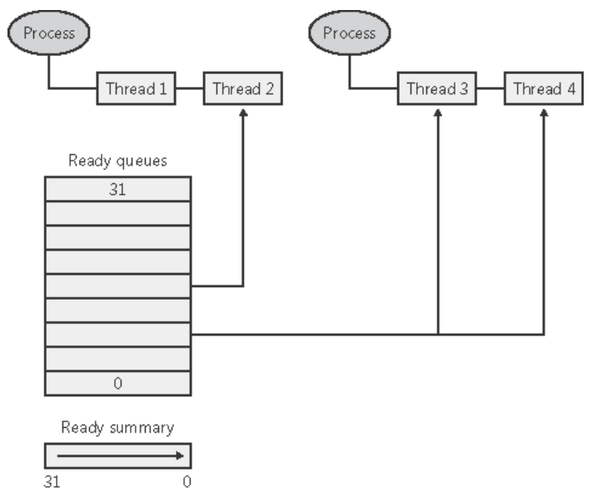
Dispatcher ready queues
Notes:
From Windows Internals curriculum:
“The dispatcher ready queues (KiDispatcherReadyListHead) contain the threads that are in the ready state, waiting to be scheduled for execution. There is one queue for each of the 32 priority levels. To speed up the selection of which thread to run or preempt, Windows maintains a 32-bit bit mask called the ready summary (KiReadySummary). Each bit set indicates one or more threads in the ready queue for that priority level. (Bit 0 represents priority 0, and so on.)”

Slide 13
Quantum
Quantum: time slice for Round Robin
Measured in clock interval (clock tick)
1 clock tick = ~ 10-15 ms (before Windows 8)
1 clokc tick = 0.5–15.6 ms (after Windos 8)
Storing quantum: “3 * number of clock tick ”
Easy to subtract fractions
At each tick quantum of the running thread decreases by 3 (~ before Vista)
Notes:
See> Windows Vista Cycle-Based Scheduling (http://technet.microsoft.com/en-us/magazine/2007.02.vistakernel.aspx?pr=blog).
The length of the clock interval varies according to the hardware platform. The frequency of the clock interrupts is up to the HAL, not the kernel. For example, the clock interval for most x86 uniprocessors is about 10 milliseconds and for most x86 and x64 multiprocessors it is about 15 milliseconds.

Slide 14
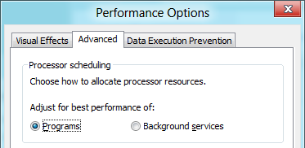
Length of the quantum
Client (XP, Vista, Win 7, Win 8):
2-6 clock tick
foreground process longer
Server
Longer quantums
Equal quantum for everyone
 | Short |  |  | Long
Variable | 6 | 12 | 18 | 12 | 24 | 36
Fixed | 18 | 18 | 18 | 36 | 36 | 36
Adjust for programs
Background services
Notes:
-- From Windows Internals Curriculum
“On Windows Vista, threads run by default for 2 clock intervals; on Windows Server systems, by default, a thread runs for 12 clock intervals. The rationale for the longer default value on server systems is to minimize context switching. By having a longer quantum, server applications that wake up as the result of a client request have a better chance of completing the request and going back into a wait state before their quantum ends.
Threads in the foreground process run with a quantum of 6 clock ticks, whereas threads in other processes have the default workstation quantum of 2 clock ticks. In this way, when you switch away from a CPU-intensive process, the new foreground process will get proportionally more of the CPU, because when its threads run they will have a longer turn that background threads (again, assuming the thread priorities are the same in both the foreground and background processes). “
Short or Long, Variable or Fixed: HKLM\SYSTEM\CurrentControlSet\Control\PriorityControl\Win32PrioritySeparation
Leírás: http://www.microsoft.com/mspress/books/sampchap/4354c.aspx

Slide 15
Length of the quantum
Clockres.exe utility
Length of Clock tick
Adjust quantum length
Perfmon
Windows Performance Analyzer
Timeline by Process, Thread view

Slide 16
Contents
Windows scheduling (basics)
Windows 8: Windows Store applications
Windows scheduling (advanced)

Slide 17
Windows 8: new application model
Design goals:
Low powers and resource-consumption
Easier deployment and upgrade
Separated applications (security, reliability)
…
Solution:
New API: WinRT
App store: Windows Store
New application lifecycle
…

Slide 18
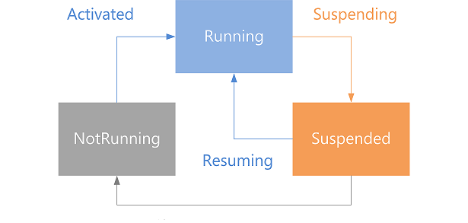
Windows Store application lifecycle
Use changes to other app.
OS suspends the process (5 sec).
App can change its state.
If saved state exists, can be restore; otherwise start from scratch
No CPU time
OS can terminate app
Terminating
Source: http://msdn.microsoft.com/en-us/library/windows/apps/hh464925.aspx

Slide 19
Windows Store applications
Windows Store
Changing between Windows Store apps
Process Explorer: Suspended state

Slide 20
Contents
Windows scheduling (basics)
Windows 8: Windows Store applications
Windows scheduling (advanced)

Slide 21
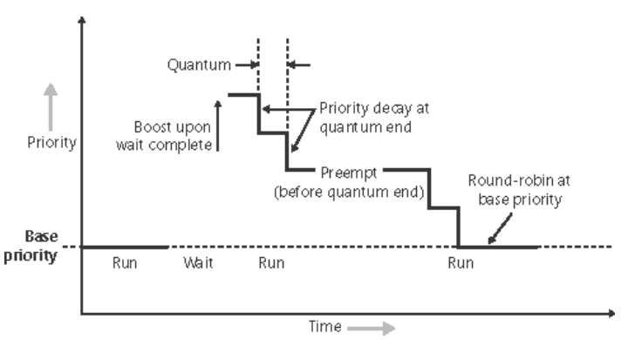
Adjusting prority
Give a change for those, who waited a long time!
Decrease priority gradually back to base priority
After wait is over, give a priority boost
Notes:
Five types:
I/O completion
Wait completion on events or semaphores
When threads in the foreground process complete a wait
When GUI threads wake up for windows input
For CPU starvation avoidance
Quantum decremented by 1 when you come out of a wait
So that threads that get boosted after I/O completion won't keep running and never experiencing quantum end
Prevents I/O bound threads from getting unfair preference over CPU bound threads

Slide 22
Preventing starvation
OS checks runnable threads (every 1 sec)
If a thread has not been executed since 300 sec
change priority to 15 (max in dynamic),
increase quantum,
for 1 quantum.

Slide 23
Symmetric Multiprocessing (SMP)
All CPU is equal
Shared address space
Interrupts can be served by an CPU
Implementation limit (length of a bit vector):
32 CPUs on 32 bit systems
64 CPUs on 64 bit systems
Change in Windows 7 / Server 2008 R2
Groups of logical processors
Supporting 4 * 64 CPU
NUMA support
CPUs
L2 Cache
Memory
I/O
SMP

Slide 24
Multiprocessor scheduling
Threads can run on any CPU by default, but
OS tries to keep on CPU, where it run (“soft affinity”)
Can be set to use only selected CPUs (“hard affinity”)
No “master processor”
Dispatcher queues:
Before Windows Server 2003 : one global queue
Windows Server 2003: per CPU queues

Slide 25
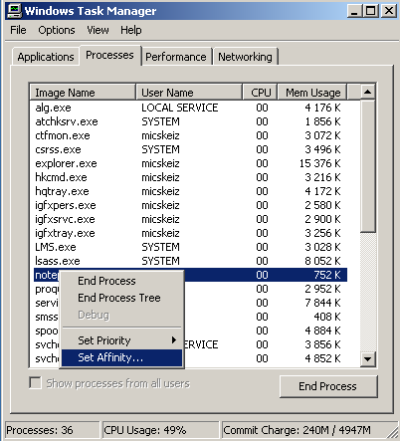
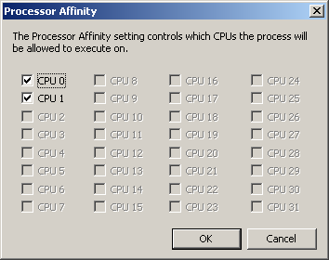
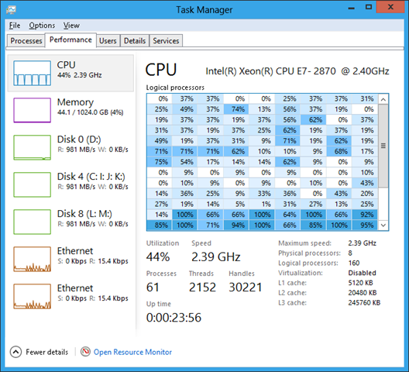
Hard Affinity
Notes:
Affinity is a bit mask where each bit corresponds to a CPU number
Hard Affinity specifies where a thread is permitted to run
Defaults to all CPUs
Thread affinity mask must be subset of process affinity mask, which in turn must be a subset of the active processor mask
Functions to change: SetThreadAffinityMask, SetProcessAffinityMask, SetInformationJobObject

Slide 26
Windows 7 changes
Core Parking (server)
Use fewer processor cores
Not used cores going to standby
Time coalescing
Timers with same periodicity are merged
Dynamic Fair Share Scheduling (DFSS)
for Remote Desktop
Every session gets a share
If share is exhausted, thread cannot run
Eliminating global locks in scheduler

Slide 27
Summary
Process ↔ Thread
Scheduling:
Priority levels
Round robin / quantum

