Slide 1
Operating Systems
Memory Management in Windows
Zoltán Micskei
http://www.mit.bme.hu/~micskeiz

Slide 2
Copyright Notice
These materials are part of the Windows Operating System Internals Curriculum Development Kit, developed by David A. Solomon and Mark E. Russinovich with Andreas Polze
Microsoft has licensed these materials from David Solomon Expert Seminars, Inc. for distribution to academic organizations solely for use in academic environments (and not for commercial use)
http://www.academicresourcecenter.net/curriculum/pfv.aspx?ID=6191
© 2000-2005 David A. Solomon and Mark Russinovich
Notes:
Slides based on Windows Operating System Internals Curriculum Development Kit

Slide 3
Question
How much free memory do I
have right now?

Slide 4
Basics of memory management in Windows
Virtual memory
Hiding physical memory, paging...
Efficiency
demand driven paging
memory sharing, copy-on-write
file caching in memory (section object)
Security
separate address space for every process
accessing through handles (access token)
Notes:
Configuring the Memory Manager
Like most of Windows, the memory manager attempts to automatically provide optimal system performance for varying workloads on systems of varying sizes and types. While there are a limited number of registry values you can add and/or modify under the key HKLM\ SYSTEM\CurrentControlSet\Control\Session Manager\Memory Management to override some of these default performance calculations, in general, the memory manager’s default computations will be sufficient for the majority of workloads.
Many of the thresholds and limits that control memory manager policy decisions are computed at system boot time on the basis of memory size and product type. (Windows 2000 Professional and Windows XP Professional and Home editions are optimized for desktop interactive use, and Windows Server systems are optimized for running server applications.)

Slide 5
Maximal physical memory (GB)
 | x86 | x64 64-bit | IA-64 64-bit
Vista Basic | 4 | 8 | n/a
Vista Business | 4 | 128 | n/a
Server 2008 Standard | 4 | 32 | n/a
Server 2008 Enterprise | 64 | 2048 | n/a
Itanium | n/a | n/a | 2048
max 4 GB can be handled
on 32 bit
64 bit: much larger
memory
Physical Address Extension (PAE)
36 address bit: CPU + OS support
Itanium: Intel server arch.,
not so popular

Slide 6
32-bit x86 address space
Default
/3GB switch
2 GB
for user
process
3 GB
for user
process
2 GB
system
space
1 GB
system
Notes:
7

Slide 7
64-bit address space
64-bit = 17,179,869,184 GB
x64 currently supports 48 address bit = 262,144 GB
x64
8192 GB
(8 TB)
for user
process
6657 GB
system
space
Notes:
7

Slide 8
Virtual Address Space (V.A.S.)
User address space:
The running application (.EXE and .DLLs)
User space stack for every thread
Data structures of the application
Accessible from
user mode
}
00000000
Unique for
every process
7FFFFFFF
Accessible only
from kernel
mode
}
80000000
Common for the
whole system
FFFFFFFF
Notes:
8
No user process can touch another user process address space (without first opening a handle to the process, which means passing through NT security)
Separate process page tables prevent this
“Current” page table changed on context switch from a thread in 1 process to a thread in another process

Slide 9
Virtual Address Space (V.A.S.)
System space:
Executive, kernel and HAL
System level data structures
Page tables (virtual → physical mapping, different for processes)
Executive heaps (pools)
Kernel mode device drivers (in the nonpaged pool)
File system cache
Kernel mode stack for every processes’ every thread
Accessible from
user mode
}
00000000
Unique for
every process
7FFFFFFF
Accessible only
from kernel
mode
}
80000000
Common for the
whole system
FFFFFFFF
Notes:
8
No user process can touch kernel memory
Page protection in process page tables prevent this
OS pages only accessible from “kernel mode”
Threads change from user to kernel mode and back (via a secure interface) to execute kernel code, this does not affect scheduling (not a context switch)
Dynamic Kernel Address Space: Windows and the applications that run on it have bumped their heads on the address space limits of 32-bit processors. The Windows kernel is constrained by default to 2GB, or half the total 32-bit virtual address space, with the other half reserved for use by the process whose thread is currently running on the CPU. Inside its half, the kernel has to map itself, device drivers, the file system cache, kernel stacks, per-session code data structures, and both non-paged (locked-in physical memory) and paged buffers allocated by device drivers. Prior to Windows Vista, the Memory Manager determined at boot time how much of the address space to assign to these different purposes, but this inflexibility sometimes led to situations where one of the regions became full while others still had plenty of available space. The exhaustion of an area can lead to application failures and prevent device drivers from completing I/O operations.
In 32-bit Windows Vista, the Memory Manager dynamically manages the kernel's address space, allocating and deallocating space to various uses as the demands of the workload require. Thus, the amount of virtual memory used to store paged buffers can grow when device drivers ask for more, and it can shrink when the drivers release it. Windows Vista will therefore be able to handle a wider variety of workloads and likewise the 32-bit version of the forthcoming Windows Server® code-named "Longhorn," will scale to handle more concurrent Terminal Server users.
Of course, on 64-bit Windows Vista systems, address space constraints are not currently a practical limitation and therefore require no special treatment as they are configured to their maximums.

Slide 10
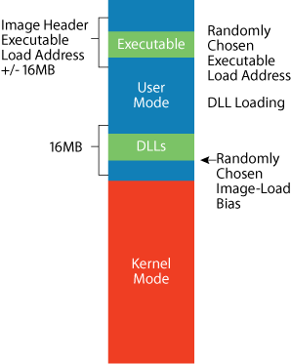
Address Space Load Randomization
Change in Vista
Security goal
System EXEs and DLLs are loaded at a random location
Notes:
Forrás: http://www.microsoft.com/technet/technetmag/issues/2007/02/VistaKernel/default.aspx
Despite measures like Data Execution Prevention and enhanced compiler error checking, malware authors continue to find buffer overflow vulnerabilities that allow them to infect network-facing processes like Internet Explorer, Windows services, and third-party applications to gain a foothold on a system. Once they have managed to infect a process, however, they must use Windows APIs to accomplish their ultimate goal of reading user data or establishing a permanent presence by modifying user or system configuration settings.
Connecting an application with API entry points exported by DLLs is something usually handled by the operating system loader, but these types of malware infection don't get the benefit of the loader's services. This hasn't posed a problem for malware on previous versions of Windows because for any given Windows release, system executable images and DLLs always load at the same location, allowing malware to assume that APIs reside at fixed addresses.
The Windows Vista Address Space Load Randomization (ASLR) feature makes it impossible for malware to know where APIs are located by loading system DLLs and executables at a different location every time the system boots. Early in the boot process, the Memory Manager picks a random DLL image-load bias from one of 256 64KB-aligned addresses in the 16MB region at the top of the user-mode address space. As DLLs that have the new dynamic-relocation flag in their image header load into a process, the Memory Manager packs them into memory starting at the image-load bias address and working its way down.
Executables that have the flag set get a similar treatment, loading at a random 64KB-aligned point within 16MB of the base load address stored in their image header. Further, if a given DLL or executable loads again after being unloaded by all the processes using it, the Memory Manager reselects a random location at which to load it. Figure 7 shows an example address-space layout for a 32-bit Windows Vista system, including the areas from which ASLR picks the image-load bias and executable load address.
Only images that have the dynamic-relocation flag, which includes all Windows Vista DLLs and executables, get relocated because moving legacy images could break internal assumptions that developers have made about where their images load. Visual Studio® 2005 SP1 adds support for setting the flag so that third-party developers can take full advantage of ASLR.
Randomizing DLL load addresses to one of 256 locations doesn't make it impossible for malware to guess the correct location of an API, but it severely hampers the speed at which a network worm can propagate and it prevents malware that only gets one chance at infecting system from working reliably. In addition, ASLR's relocation strategy has the secondary benefit that address spaces are more tightly packed than on previous versions of Windows, creating larger regions of free memory for contiguous memory allocations, reducing the number of page tables the Memory Manager allocates to keep track of address-space layout, and minimizing Translation Lookaside Buffer (TLB) misses.

Slide 11
Memory allocation
Two steps
Reserve: reserving virtual address space
Commit: allocating the virtual memory
Only commits what is really needed

Slide 12
Shared memory
E.g. multiple processes use the same file
Process 1
Disk
Process 2
00000000
User mode
v.a.s.
User mode
v.a.s.
7FFFFFFF
Physical
memory

Slide 13
Working Set
Working Set:
Physical memory pages belonging to a process
Can be accessed without a page fault
Working set limit:
Maximal physical memory a process can have
If reached, should switch pages:
NT 4.0: modified FIFO algorithm
Windows 2000: Least Recently Used (UP systems)
If free memory falls under a limit: trimming
Notes:
Working set: Implemented as array of working set list entries (WSLE)

Slide 14
Lifecycle of physical pages
demand zero page faults
page read from disk or kernel allocations
Standby
Page List
Free
Page List
Zero
Page
List
Bad
Page
List
Process
Working
Sets
“soft”
page
faults
modified
page
writer
zero
page
thread
Modified
Page List
working set replacement
Private pages at process exit
Notes:
Status Description
Active/valid: Page is part of working set (sys/proc), valid PTE points to it
Transition: Page not owned by a working set, not on any paging list, I/O is in progress on this page
Standby: Page belonged to a working set but was removed; not modified
Modified: Removed from working set, modified, not yet written to disk
Modified no write: Modified page, will not be touched by modified page write, used by NTFS for pages containing log entries (explicit flushing)
Free: Page is free but has dirty data in it – cannot be given to user process – C2 security requirement
Zeroed: Page is free and has been initialized by zero page thread
Bad: Page has generated parity or other hardware errors

Slide 15
Page file
What?
Only modified data, not the code
When?
Also if there is free memory
Processes cannot use as much physical memory as they like
Reservation for new processes
One page file for each partition
Recommended: not on the system drive
But create a small one for the crash dump file
Recommended size
1,5 times physical memory (?), Fixed size (?)
Notes:
Windows XP (& Embedded NT4) can run with no paging file
NT4/Win2K: zero pagefile size actually creates a 20MB temporary page file (\temppf.sys)
WinPE never has a pagefile
Page file maximums:
16 page files per system
32-bit x86: 4095MB
32-bit PAE mode, 64-bit systems: 16 TB
How to configure paging files for optimization and recovery in Windows XP (http://support.microsoft.com/kb/314482/en-us)

Slide 16
DEMO
Changing the size of the page file
GUI
regedit
Perfmon: Page file utilization (%)
Sysinternals: pagedfrg.exe
Page file
Notes:
Page file: GUI: System Properties / Advanced / Performance, Settings / Advanced / Virtual Memory, Settings
Registry: HKEY_LOCAL_MACHINE\SYSTEM\CurrentControlSet\Control\Session Manager\Memory Management

Slide 17
Memory usage
Simple question:
How much memory does a process consume and for what?

Slide 18
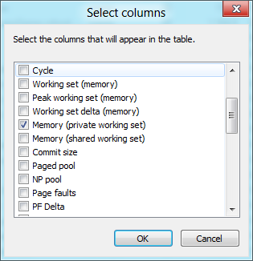
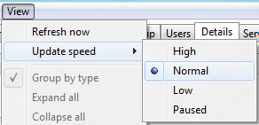
Process memory usage - 0
Task manager
Update speed

Slide 19
Process memory usage - 1
1
2
3
Memory - Working Set
shared pages also
Memory – Private Working Set
without shared pages
1
2
Memory – Commit size
private virtual memory
this goes to the page file
3
Notes:
http://windowshelp.microsoft.com/Windows/en-US/help/e4598b92-b1c1-bc52-5e30-6871dcc59ca01033.mspx

Slide 20
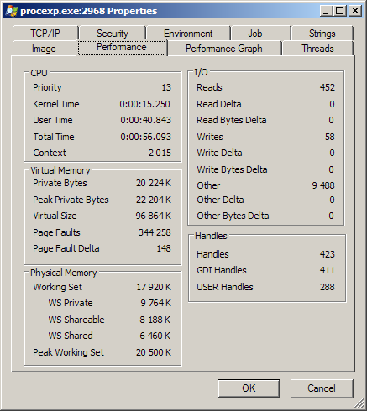
Process memory usage - 2
Process Explorer:
Details in the process property
Virtual Memory
Physical Memory

Slide 21
DEMO
Sysinternals VMmap
Process memory usage

Slide 22
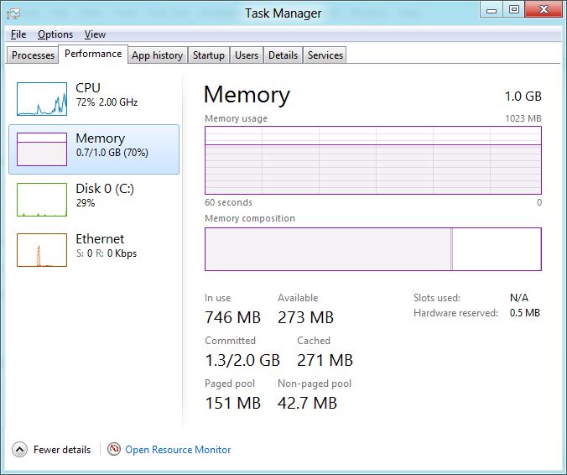
System memory usage
1
All committed virtual memory
This should go to the page file, does not mean it is currently in the page file
2
Commit limit: physical memory + actual size of the page files
3
4
1
2
3
~ Active memory pages
4
Standby list

Slide 23
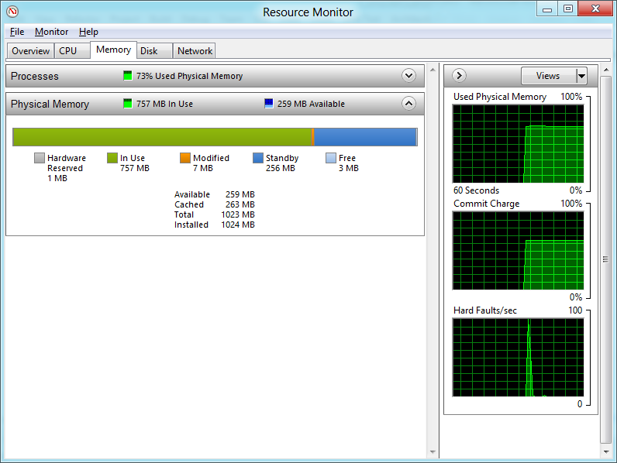
Demo
Resource monitor
Notes:
MemInfo: Peer Inside Memory Manager Behavior on Windows Vista and Server 2008
http://www.alex-ionescu.com/?p=51

Slide 24
Optimalization: Prefetch (Windows XP)
Many page fault at the start of the application
Always the same pages are needed
Prefetch: watching the first 10 seconds
Prefetch “trace file”: \Windows\Prefetch
Name: .EXE-<hash from full path>.pf
On next startup
Needed pages are loaded asynchronously
Watching the boot sequence also
Notes:
Details: http://msdn.microsoft.com/msdnmag/issues/01/12/XPKernel/default.aspx

Slide 25
Another: Superfetch (Vista)
8 priorities to the memory pages
8 standby list for each priority
Monitoring the usage of pages
After memory deallocations pages are slowly moved back to the standby list
Notes:
Source: http://technet.microsoft.com/en-us/magazine/cc162480.aspx
A significant change to the Memory Manager is in the way that it manages physical memory. The Standby List management used by previous versions of Windows has two limitations. First, the prioritization of pages relies only on the recent past behavior of processes and does not anticipate their future memory requirements. Second, the data used for prioritization is limited to the list of pages owned by a process at any given point in time. These shortcomings can result in scenarios like the "after lunch syndrome," where you leave your computer for a while and a memory-intensive system application runs (such as an antivirus scan or disk defragmentation). This application forces the code and data that your active applications had cached in memory to be overwritten by the memory-intensive activities. When you return, you experience sluggish performance as applications have to request their data and code from disk.
Windows XP introduced prefetching support that improved boot and application startup performance by performing large disk I/Os to preload memory with code and file system data that it expected, based on previous boots and application launches. Windows Vista goes a big step further with SuperFetch, a memory management scheme that enhances the least-recently accessed approach with historical information and proactive memory management.
SuperFetch is implemented in %SystemRoot%\System32\Sysmain.dll as a Windows service that runs inside a Service Host process (%SystemRoot%\System32\Svchost.exe). The scheme relies on support from the Memory Manager so that it can retrieve page usage histories as well as direct the Memory Manager to preload data and code from files on disk or from a paging file into the Standby List and assign priorities to pages. The SuperFetch service essentially extends page-tracking to data and code that was once in memory, but that the Memory Manager has reused to make room for new data and code. It stores this information in scenario files with a .db extension in the %SystemRoot%\Prefetch directory alongside standard prefetch files used to optimize application launch. Using this deep knowledge of memory usage, SuperFetch can preload data and code when physical memory becomes available.
Whenever memory becomes free-for example, when an application exits or releases memory-SuperFetch asks the Memory Manager to fetch data and code that was recently evicted. This is done at a rate of a few pages per second with Very Low priority I/Os so that the preloading does not impact the user or other active applications. Therefore, if you leave your computer to go to lunch and a memory-intensive background task causes the code and data from your active applications to be evicted from memory while you're gone, SuperFetch can often bring all or most of it back into memory before you return. SuperFetch also includes specific scenario support for hibernation, standby, Fast User Switching (FUS), and application launch. When the system hibernates, for example, SuperFetch stores data and code in the hibernation file that it expects (based on previous hibernations) will be accessed during the subsequent resume. In contrast, when you resume Windows XP, previously cached data must be reread from the disk when it is referenced.
See the sidebar "Watching SuperFetch" for a glimpse of how SuperFetch impacts available memory.

Slide 26
Process Monitor: files used at application startup
Prefetch files
C:\Windows\Prefetch
Layout.ini
Content of a prefetch file:
strings.exe
Prefetch

Slide 27
Summary
Virtual memory, paging
Multiple optimalization
Analysing memory usage
Task manager: quick summary
Process Explorer, Meminfo: details

Slide 28
To read
Windows XP Kernel Improvements: Prefetch
Inside the Windows Vista Kernel:
1. part: Multimedia Class Scheduler
2. part: Superfetch, Ready*
XP Myths: Prefetch and other misconceptions
MemInfo: Peer Inside Memory Manager Behavior on Windows Vista and Server 2008

