Slide 1
Virtualization
Operating system (vimia219)
Zoltan Micskei
http://www.mit.bme.hu/~micskeiz
Notes:
Last modified: 2014. 04. 24.

Slide 2
Virtualization
Central concept in computers
Virtualization: hiding the actual parameters of a resource from its users, e.g.
presenting a resource as separate logical ones,
presenting separate resources as one logical…
Virtual memory, virtual filesystem…

Slide 3
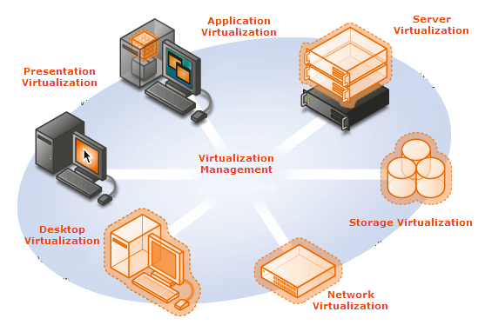
The virtualization buzzword
Packaged applications
Computer virtualization
Misused termonology
Thin clients
Dymamic management, lifecycle, templates…
Hiding the storage structure
+ OS level virtualization:
separate OS containers
Desktop products
Notes:
Source: http://www.microsoft.com/virtualization/default.mspx

Slide 4
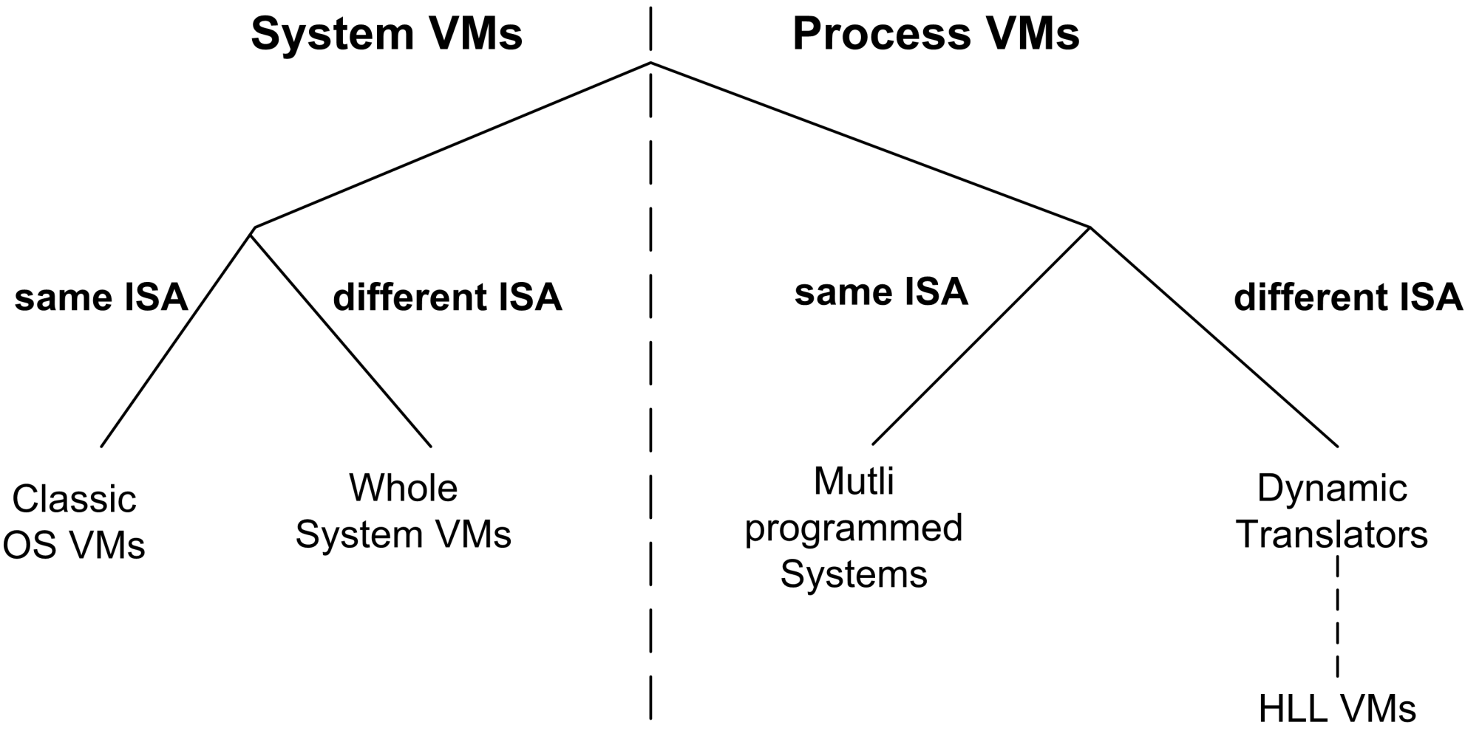
Virtual machine taxonomy*
VM sees an ABI
VM sees a hardware
Java, .NET…
Multiprog-rammed OS
Source: J. Smith and Ravi Nair, “The architecture of virtual machines,” IEEE Computer, vol. 38, 2005, pp. 32-38.
* taxonomy ~ structure for presenting relationships between concepts
Notes:
Source: J. Smith and Ravi Nair, “The architecture of virtual machines,” IEEE Computer, vol. 38, 2005, pp. 32-38.
http://ieeexplore.ieee.org/xpls/abs_all.jsp?arnumber=1430629
Process VM: „A process VM is a virtual platform that executes an individual process. This type of VM exists solely to support the process; it is created when the process is created and terminates when the process terminates.”
System VM: „A system VM provides a complete, persistent system environment that supports an operating system along with its many user processes. It provides the guest operating system with access to virtual hardware resources, including networking, I/O, and perhaps a graphical user interface along with a processor and memory. ”
ISA: Instruction Set Architecture
ABI: Application Binary Interface
API: Application Programming Interface

Slide 5
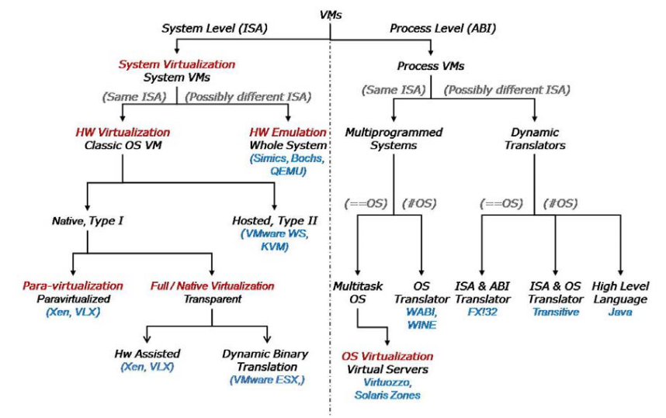
Virtual machine taxonomy (detailed)
Notes:
Source: Scope Alliance, Virtualization: State of the Art, 2008.
http://scope-alliance.org/sites/default/files/documents/SCOPE-Virtualization-StateofTheArt-Version-1.0.pdf

Slide 6
Platform virtualization
Platform virtualization: virtualizing a full computer, running multiple OS on one hardware
Also known as: server, computer, hardware virtualization..
Concepts:
Host machine = physical computer
Guest machine = virtual computer
Virtual Machine Monitor (VMM): program managing the virtual machines

Slide 7
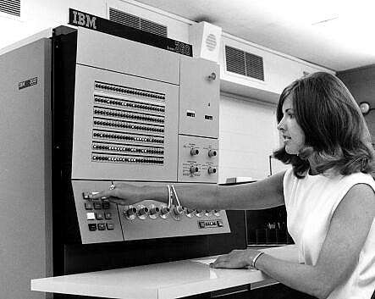
History of platform virtualization
~1960 - IBM CP-40 system
in the mainframe products
x86 virtualization
Seemed impossible
1997: Stanford, Disco projects
1998: VMware solution
2000- Other solutions
Now:
has its own business
becomes commodity
Notes:
Source: IBM Mainframes reference room
http://www-03.ibm.com/ibm/history/exhibits/mainframe/mainframe_room.html

Slide 8
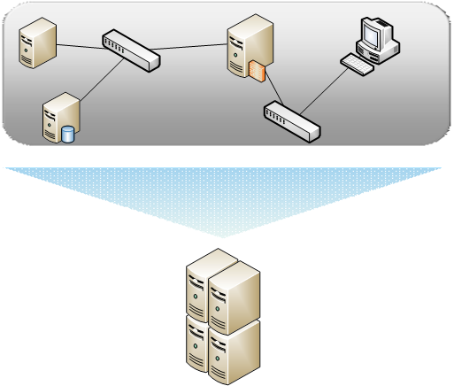
Why is platform virtualization good?
Building test systems
HW consolidation
Legacy systems
On-demand architectures
High availability, disaster recovery
Portable applications
…

Slide 9
Platform virtualization
Two approaches:
GUEST
App.
App.
Management App.
App.
App.
App.
OS
OS
Management OS
OS
OS
OS
Virt. SW
Virt. SW
Hardware
Hardware
Neve:
VMM – Virtual Machine Monitor
Hypervisor
Main component:
VMM – Virtual Machine Monitor
Hosted
HOST
Bare-metal
Mainly desktop productsL: VMware Workstation, Server, Player, Oracle VirtualBox, MS VirtualPC, KVM, UML
Mainly server products:
VMware ESX Server, Xen Enterprise, MS Hyper-V

Slide 10
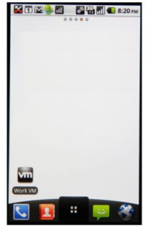
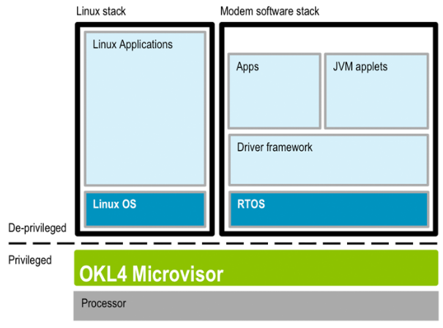
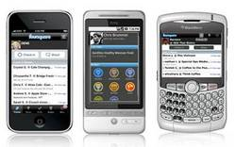
Use case: mobil virtualization
Notes:
Sources:
Left: http://www.ok-labs.com/solutions/what-is-mobile-phone-virtualization
Right: http://mobiputing.com/2010/12/vmware/

Slide 11
Theoretical background

Slide 12
Requirements
Requirements for a virtualization solution:
Equivalence: programs in a VM should perform indistinguishable from running on the hardware
Resource control: the VMM should handle all the physical resources
Efficiency: most of the VM’s instructions should run directly on the hardware
Gerald J. Popek, Robert P. Goldberg: Formal Requirements for Virtualizable Third Generation Architectures. Commun. ACM 17(7): 412-421 (1974)

Slide 13
Main problem
The system must be protected from the guests
E.g.: HLT (Halt) instruction
Desirable: only the VM should stop
But all VMs would stop if executed
Solution: VMM monitors the guest instructions
Privileged instructions should be handled

Slide 14
Theoretical background
CPU virtualization
Memory virtualization
I/O virtualization

Slide 15
Basic methods – Full emulation
Full state of the virtual hardware is stored in the emulator
(registers, flags)
Virtual machine
Application
Virtual HW
Every instruction is
inspected by the VMM
Emulator
State of virtual HW
Instruction is applied in the emulator, transforms the instruction, executes
Pro:
Different CPU can be emulated
Con:
Slow
HW

Slide 16
Basic methods – Trap and emulate
Trap: hardware exception handling, which resumes execution after the handler
Virtual machine
Application
Non-privileged instructions are
directly executed on the hardware
Virtual HW
Emulator
Privileged or sensitive instructions cause a trap, VMM handles it
State of virtual HW
HW support is required:
protection modes (e.g. x86 ring)
VM runs in a lower mode
Privileged instructions should case a trap when called from a non-privileged mode
HW
Notes:
Non-sensitive, unprivileged application instructions can be executed directly on the processor with no VMM intervention.
Sensitive, privileged instructions will be detected when they trap after being executed in user mode. The trap should be delivered to the VMM that will emulate the expected behavior of the instruction in software.
Sensitive, unprivileged instructions must be detected so that control can be transferred to the VMM.

Slide 17
Issues with x86 virtualization
Some architectures can be easily virtualized
x86 cannot
From ~250 instructions 17 violate the classical requirements, e.g.
POPF instruction: modifies EFLAGS register
But if not executed in ring 0, doesn’t throw an exception
Privileged state can be detected
OS can detected whether it’s running in a VM
Conclusion: the trap & emulate method cannot be used on the original x86
Notes:
See: J. S. Robin and C. E. Irvine. Analysis of the Intel Pentium's ability to support a secure virtual machine monitor. In Proceedings of the 9th USENIX Security Symposium, Denver, CO, USA, pages 129.144, Aug. 2000.

Slide 18
Solutions for virtualizing x86
Binary translation (software)
Paravirtualization
Hardware-assisted virtualization
Notes:
Ez egyben időbeli sorrend is, így jelentek meg ezek a módszerek.

Slide 19
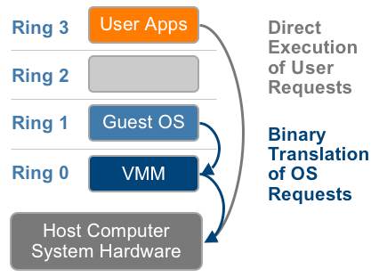
Binary translation
most of the instructions run directly
privileged instructions translated runtime
doesn’t need source
caches translated code
guest OS not aware of virtualization
Notes:
Source: VMware, Understanding Full Virtualization, Paravirtualization, and Hardware Assisted Virtualization
http://www.vmware.com/files/pdf/VMware_paravirtualization.pdf

Slide 20
Binary translation – example
Guest Code
Translation Cache
vEPC
mov ebx, eax
mov ebx, eax
start
cli
mov [VIF], 0
and ebx, ~0xfff
and ebx, ~0xfff
mov ebx, cr3
mov [CO_ARG], ebx
sti
call HANDLE_CR3
ret
mov [VIF], 1
test [INT_PEND], 1
jne
call HANDLE_INTS
jmp HANDLE_RET
Source: Carl Waldspurger, Introduction to Virtual Machines
Notes:
Source: http://labs.vmware.com/academic/mit-iap-2010

Slide 21
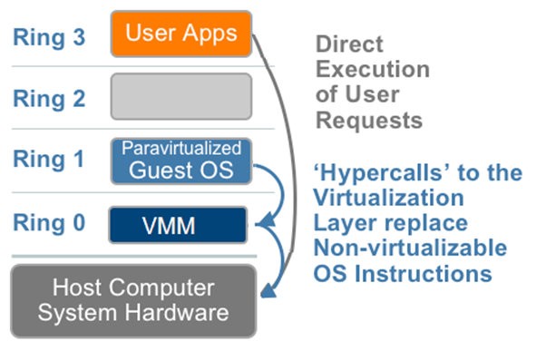
Paravirtualization
Modifying the source of the guest OS
Replacing “problematic” instructions
Hypercall: calling the VMM directly

Slide 22
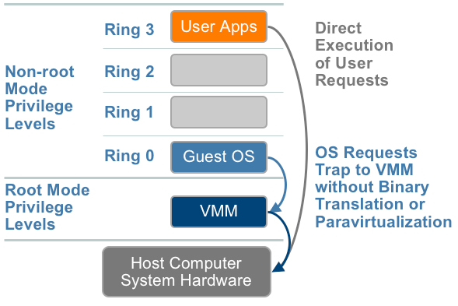
Hardware-assisted virtualization
~2005: Intel Virtualization Technology (VT-x) and AMD AMD-V
HW support: root mode, VMCS
Instructions: VMCALL, VMLAUNCH
trap & emulate now works
Notes:
Intel VT-x:
VMCS (Virtual Machine Control Structure)
VMLAUNCH Launches a virtual machine managed by the VMCS. A VM entry occurs, transferring control to the VM.
VMCALL Allows a guest in VMX non-root operation to call the VMM for service. A VM exit occurs, transferring control to the VMM.
More info:
Intel® Virtualization Technology: Hardware Support for Efficient Processor Virtualization, Intel Technology Journal, Volume 10, Issue 03, http://www.intel.com/technology/itj/2006/v10i3/1-hardware/1-abstract.htm

Slide 23
What is the best?
Answer changes constantly☺
Depends on the environment, workload
BT used to be more matures, but..
Most products mix several techniques
2006. VMware: BT is better than HW assisted virtualization
2008. VMware: Paravirtalization + BT is better than pure BT
2009. Comparing Hardware Virtualization Performance Utilizing VMmark v1.1
Notes:
Binary translation: VMware Player/Workstation, VMware ESX (some 32 bit guest), Virtual PC, MS Virtual Server
Paravirtualization: Xen (Linux VM), partially MS Hyper-V (for some Windows and Linux)
HW virtualization: Xen (Windows VM), MS Hyper-V (HW support is a requirement), VMware (64 bit guest)

Slide 24
Theoretical background
CPU virtualization
Memory virtualization
I/O virtualization

Slide 25
Memory virtualization (software)
Guest page tables
VM1
VM2
Guest: virtual memory
Guest: „physical” memory
Machine: physical memory
VM allocation page tables
Instead of double translation: shadow page tables
ISSUE: synchronization
Notes:
More info on VMware’s solution: C.A. Waldspurger, “Memory resource management in VMware ESX server,” SIGOPS Oper. Syst. Rev., vol. 36, 2002, pp. 181-194. , http://www.waldspurger.org/carl/papers/esx-mem-osdi02.pdf

Slide 26
Memory virtualization (paravirtualization)
Also uses shadow page tables
Modifying the guest OS source code
When the OS modifies it’s page tables, it should notify the VMM also

Slide 27
Memory virtualization (hardware)
HW support in the recent CPUs
AMD Rapid Virtualization Indexing , Intel Extended Page Tables
Nested page table
Storing guest physical -> machines physical translation
Traversed by HW address translation
Tagging TLB entries
Great performance increase:
2008. 04., KVM: MMU paravirtualization is dead
2009., VMware: Performance Evaluation of AMD RVI Hardware Assist, 42% improvement in some cases
Notes:
More info on AMD RVI: http://developer.amd.com/assets/NPT-WP-1%201-final-TM.pdf

Slide 28
Theoretical background
CPU virtualization
Memory virtualization
I/O virtualization

Slide 29
Handling I/O devices (software)
Virtual machine
Emulating the whole real communication
Guest OS
Unmodified driver
VMM
Emulated virtual HW
HW manager
I/O device

Slide 30
Handling I/O devices (paravirtualization)
Virtual machine
Virtual machine
Guest OS
Guest OS
Unmodified driver
Paravirt. driver
Simplified calls,
communication through shared memory
VMM
VMM
Emulated virtual HW
HW manager
HW manager
I/O device
I/O device
Special package installed in the VM:
VMware Tools, Virtual PC Additions
Always install these!

Slide 31
Handling I/O devices (hardware)
Hardware support
Intel VT-d, AMD IOMMU
PCI standard extensions: I/O Virtualization (IOV)
I/O devices
can be shared between VMs
can be directly assigned to one VM
Notes:
More info: Carl Waldspurger and Mendel Rosenblum. 2012. I/O virtualization. Commun. ACM 55, 1 (January 2012), 66-73. DOI=10.1145/2063176.2063194 (http://doi.acm.org/10.1145/2063176.2063194)

Slide 32
Products and companies

Slide 33
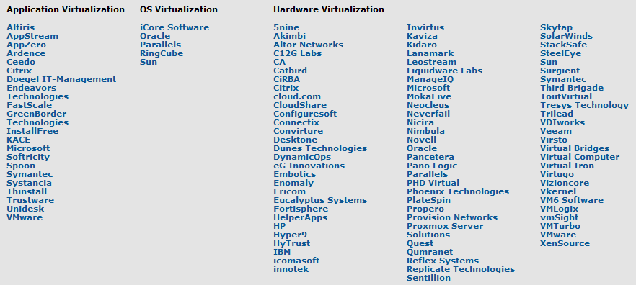
Players
http://www.virtualization.info/radar/
Notes:
Or: http://en.wikipedia.org/wiki/Comparison_of_virtual_machines

Slide 34
Players
 | ESXi, vSphere…
 | open source hypervisor
 | XenServer, XenApp
 | Virtual PC, Hyper-V, System Center
 | Solaris Containers, Oracle VM, VirtualBox
 | Kernel based Virtual Machine (KVM)
 | mainframe, powerVM
 | …
Notes:
Only a partial list!

Slide 35
Centralized management
Resource pools
VM maps
Performance graphs
Live Migration – moving VMs between hosts on the fly

Slide 36
Cloud computing
???

Slide 37
Cloud computing
Cloud

Slide 38
Types of cloud computing
IaaS
Getting a VM
Amazon EC2, RackSpace…
PaaS
Getting a runtime environment
MS Azure, Google AppEngine…
SaaS
Getting a service
Google Docs, SalesForce CRM…
Java container, .NET, database…
Notes:
IaaS = Infrastructure as a Service
PaaS = Platform as a Service
SaaS = Software as a Service

Slide 39
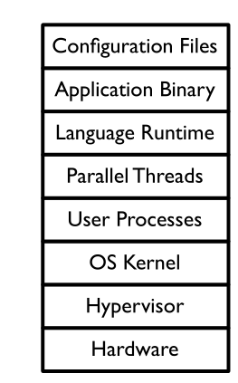
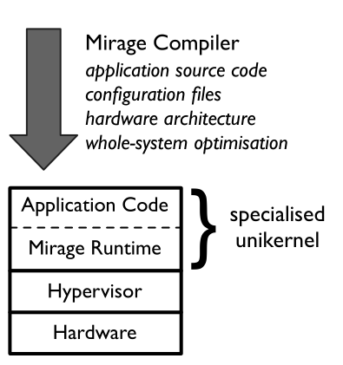
Future (?): Mirage OS

Slide 40
More information
Ole Agesen et al.: The evolution of an x86 virtual machine monitor, SIGOPS Oper. Syst. Rev. 44, 4 (December 2010)
P. Barham et al.: Xen and the Art of Virtualization, SIGOPS Oper. Syst. Rev. 37, 5 (October 2003)

Slide 41
Summary
Virtualization: became commodity
Conflicting terminology
Many competing vendors
Operating systems
Core functions implemented in the hypervisor
Purpose of general OS?

