Slide 1
Authentication and authorization
Operating systems (vimia219)
Tóth Dániel, Micskei Zoltán

Slide 2
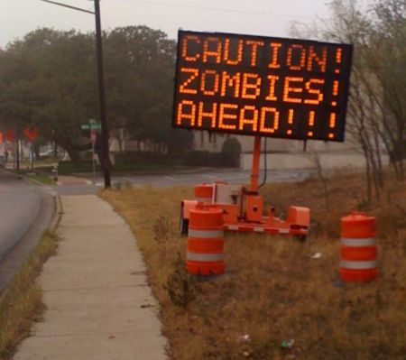
Security of computer systems
Is it important?
Is it important for everyone?
When is it important?

Slide 3
When is security important?
In every phase of software development
If the system was not designed for security, it is really hard to make it secure.
Security is determined by the weakest link.
design
implementation
operation

Slide 4
What is security?
„C.I.A.”: three related concepts
Goal:
guarantee that the systems behaves always as expected
One technology is usually not enough
Integrity
Availability
Confidentiality

Slide 5
Methods for security
Cryptography
For the integrity and confidentiality of communication
Platform-level intrusion detection
Integrity if the applications
Network-level intrusion detection
Redundancy, reconfiguration
For availability
Authentication, authorization
Integrity
Availability
Confidentiality

Slide 6
Who is “authorized”?
Authorization
Authentication
Am I really that?
Who am I?
What do I have access to?
What can I do with it?

Slide 7
Content
Short security introduction
User management, authentication
UNIX, Linux
Windows
Authorization
General methods
Role-based access control
Access control lists
Authorization on UNIX/Linux
Authorization on Windows
On the last lecture of the semester

Slide 8
Authentication
How can be the identity of the user decided?
…knows (e.g. password)
…has (e.g. keycard, security token)
…is (e.g. biometric, fingerprint)
A (non-compromised) machine can decide the identity of the user using these methods
But what if the machine is compromised?
What to do with machine-machine communication?

Slide 9
Authentication
Authentication on 3 levels:
Human–machine interaction
Machine–machine interaction over network
Between processes inside an OS
Authentication protocols are needed
Machine–machine only the “knows” principle
But complex cryptographic primitives can be used

Slide 10
What is a user account?
User
+ ID
+ Name
+ Real Name
+ Personal data…
+ Shared Secret (Password, etc.)
+ Private Datastore path
For the system, the user is an object…

Slide 11
What is a user account?
Unique identifier for an account
Linux, UNIX: UID (integer, root 0, users 1000-…)
Further attributes of an account
Stored in /etc/passwd, /etc/shadow, /etc/groups
Examples
Login name
Password
Home directory
Default shell
Real name…

Slide 12
User account on Linux
Stored in the following files:
/etc/passwd
/etc/shadow
/etc/group
Create, delete, modify
useradd, usermod, userdel
groupadd, groupmod, groupdel
passwd
Notes:
+ Egy kis ismerkedés a man oldalakkal!

Slide 13
User account on Linux
User
Group
Initial group
+ UID
+ name
+ password
+ shell
+ home directory
+ comment
+ expiry date
+ GID
+ name (+ password)
*
1
members
*
*
Notes:
Meglehetősen ritkán használt funkció a csoporthoz hozzárendelt jelszó, de van ilyen is.

Slide 14
Process identity
Identifying the identity of a process
ps aux, pstree, /proc/$PID/status
Changing effective user és group runtime
setuid, setgid
su, sudo

Slide 15
Authentication on Linux
Between machines (e.g. ssh)
User name / password
Private / public key
Egyediség?

Slide 16
Content
Short security introduction
User management, authentication
UNIX, Linux
Windows
Authorization
General methods
Role-based access control
Access control lists
Authorization on UNIX/Linux
Authorization on Windows

Slide 17
Authorization in general
Protected objects
Security policy
?
Data
?
?
Resources
Actor, Subject
Data structure of actor
Actor is represented by a data structure
Permissions are a relationship between actors and protected objects

Slide 18
Executing operations
Read(Data1)
policy
enforcement point
approved
Data1
policy decision point
✓
✗
Data2
✓
Resource 3

Slide 19
General concepts
Actors initiate operations
The context of the operation includes the identifier of the actor, the protected object and the type of operation
The policy decision component evaluates:
approves or denies the operation
The policy enforcement component assures that the result is enforced

Slide 20
Challenges in authorization
There are many actors in the system
Moreover: different systems identify the users differently
There are many protected objects
The whole relationship:
(Actors) X (Objects) X (Types of operation)
This is called access matrix
It is unmanageable, the whole matrix is huge!

Slide 21
Categorizing authorization methods
Authorization categories
Compulsoriness
Mandatory
Discretionary
Level
System level
Resource level
Types
Integrity control
Access control lists
Notes:
A csoportosítás esetleges, rengeteg egyéb szempont van természetesen.

Slide 22
Category: Compulsoriness
Classical concepts (US DoD standard)
Mandatory
security policy is managed centrally
users cannot change the policy
Discretionary
the owner of the resource can change the permissions

Slide 23
Category: type
Integrity control
Labeling objects
Integrity level: high – low, public – secret
Typical validation:
lower level actor cannot read a higher level object
Bell-LaPadula (confidentiality) and Biba (integrity)
„No read up”
„No write down
„No write up”
„No read down”

Slide 24
Category: type
Integrity control
Labeling objects
Integrity level: high – low, public – secret
Typical validation:
lower level actor cannot read a higher level object
Bell-LaPadula (confidentiality) and Biba (integrity)
Access control lists
object → (actor, permissions)
Permission: read, write, execute…

Slide 25
Access control lists
+ mask
*
+ OP1()
+ OP2()
Actor
Access mask: contains the operations the permission is defined for
Permission
Protected object

Slide 26
Access control lists
A permission can be defined for a set of objects
+ mask
*
*
+ OP1()
+ OP2()
Actor
Permission
Protected object
Sometimes the ordering is also defined

Slide 27
Role-based Access Control (RBAC)
Role makes defining actors hierarchically possible
*
+ mask
*
*
*
*
Actor
Role
Permission
Protected object
The number of permissions can be greatly reduced

Slide 28
Hierarchy between objects
If there is a hierarchy between objects…
*
1
*
+ mask
+inherit
*
*
*
*
Actor
Role
Permission
Protected object
…a permission can be defined for a subtree of objects using inheritance

Slide 29
Groups
User
memberOf
Group
Group membership is a method for implementing RBAC
+ Name (+ Purpose…)
(+ Shared Secret)

Slide 30
Content
Short security introduction
User management, authentication
UNIX, Linux
Windows
Authorization
General methods
Role-based access control
Access control lists
Authorization on UNIX/Linux
Authorization on Windows

Slide 31
POSIX file system permissions
Basic concepts
Acotr: user
Hierarchy of actors: group
A user can be member of several group
A group can contain several user
Group cannot contain an other group
Permissions
3x3 bit: read, write, execute (entering a directory)
First 3: for the owner of the object
Second 3: for the group of the object
Third 3: everyone else
Special bits:
setuid, setgid: when running changes the uid, gid to the owner
sticky: sets the owner of new objects

Slide 32
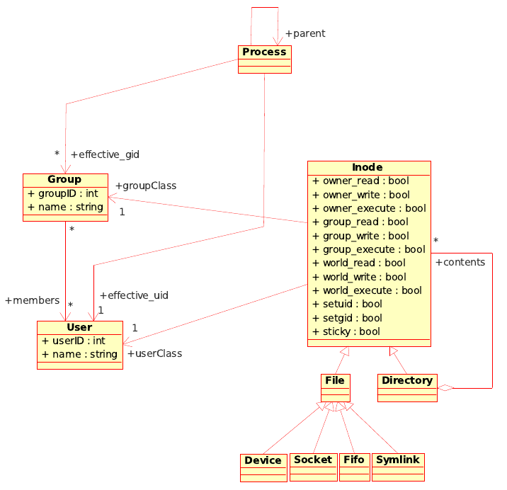
POSIX fájlrendszer jogosultságok

Slide 33
Linux permissions
Changing owner: chown
can be executed only by the root
Changing permissions: chmod
Only allowed to the owner of the object
Several styles for permissions:
4 octal numbers
Changing e.g.: u+x (add execute for user), g-w (remove write for group)
Listing:
ls –l
ls –l –n

Slide 34
Other privileges
Root has special privileges:
Can set real-time class scheduling
Can access I/O devices directly (!)
Can listen on TCP ports below 1024
Can change kernel parameters, load kernel module, etc.
…
But this also should be modifiable
Principle of least privileges
Method: POSIX Capabilities (method for assigning global system-level privileges)
Notes:
Capability: /usr/src/linux/include/linux/capability.h

