Slide 1
Operating Systems
Security Subsystem in Windows
Zoltán Micskei
http://www.mit.bme.hu/~micskeiz
Notes:
Last changed: 2012. 05. 09.

Slide 2
Copyright Notice
These materials are part of the Windows Operating System Internals Curriculum Development Kit, developed by David A. Solomon and Mark E. Russinovich with Andreas Polze
Microsoft has licensed these materials from David Solomon Expert Seminars, Inc. for distribution to academic organizations solely for use in academic environments (and not for commercial use)
http://www.academicresourcecenter.net/curriculum/pfv.aspx?ID=6191
© 2000-2005 David A. Solomon and Mark Russinovich
Notes:
Slides based on Windows Operating System Internals Curriculum Development Kit

Slide 3
Questions
SID
HKLM
BSOD
Notes:
BSOD: Blue Screen of Death
SID: Security Identifier
HKLM: HKEY_LOCAL_MACHINE

Slide 4
Security tasks in Windows
Authentication
  Has / Knows / Is
  E.g. logon screen, password popup
Authorization
  Principle: Role based access control
  E.g. access control lists
Auditing
  Audit logging

Slide 5
Security tasks in Windows
Authentication
  Has / Knows / Is
  E.g. logon screen, password popup
Authorization
  Principle: Role based access control
  E.g. access control lists
Auditing
  Audit logging

Slide 6
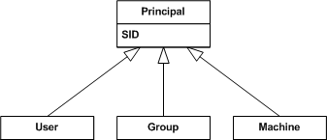
Security entities in Windows

Slide 7
Security Identifier (SID)
Unique identifier
E.g. SID of a machine:
S-1-5-21-2052111302-1677128483-839522115
Users, groups:
  <Machine SID>-<RID>
  RID: relative identifier
Well-known SIDs
  Everyone: S-1-1-0
  Administrator: S-1-5-domain-500
Vista: services also get their own SIDs
Notes:
Well-known security identifiers in Windows operating systems
http://support.microsoft.com/kb/243330

Slide 8
DEMO
Security identifier (SID)
psgetsid.exe machineName
psgetsid.exe administrator
psgetsid.exe <user>
Notes:
psgetsid: sysinternals program

Slide 9
Authentication
Login
  Through Winlogon’s own desktop
  Secure Attention Sequence: Ctrl + Alt + Del
  Windows 8: Microsoft account, picture password
Storing passwords:
  Hash in the registry
Network authentication
  NTLM: NT LAN Manager
  Kerberos: since Windows 2000,
  in domain environment
Notes:
Why is Control-Alt-Delete the secure attention sequence (SAS)? (http://blogs.msdn.com/larryosterman/archive/2005/01/24/359850.aspx)

Slide 10
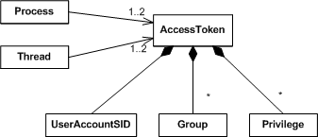
Authentication – Access token
Impersonation

Slide 11
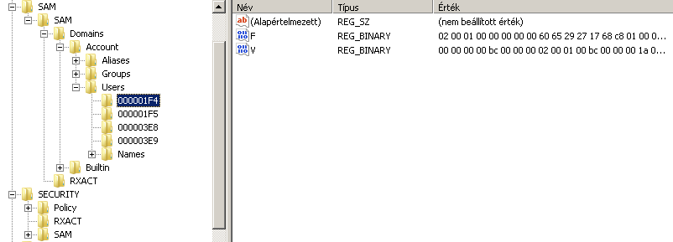
DEMO
Security Account Manager DB
registry
  HKEY_LOCAL_MACHINE\SAM
viewing: psexec –s –i regedit.exe

Slide 12
Security tasks in Windows
Authentication
  Has / Knows / Is
  E.g. logon screen, password popup
Authorization
  Principle: Role based access control
  E.g. access control lists
Auditing
  Audit logging

Slide 13
Categorizing authorization (see prev. lecture)
Authorization categories
Compulsoriness
Mandatory
Discretionary
Level
System level
Resource level
Types
Integrity control
Access control lists

Slide 14
Authorization - Compulsoriness
Classical concepts (US DoD standard)
Mandatory
  Only central access control
  Users cannot change the policy
Discretionary
  authorized users can change policies

Slide 15
Authorization – Level
System level
  Privilege
  Account right
Resource level
  Integrity level
  Access control list

Slide 16
Authorization – Types
Integrity control
  Labeling objects
    low, medium, high…
  Check:
    user with a lower integrity label cannot read up/write up
Access control list
  Object → (SID, permissions)
    Permission: write data, read attribute…

Slide 17
Authorization methods in Windows
Mandatory Integrity Control
System level privileges and rights
Discretionary Access Control

Slide 18
DEMO
Mandatory Integrity Control
Vista feature
icacls /setintegritylevel H|M|L
Trying „No write up”
  psexec –l cmd.exe: starts with low integrity
e.g. Internet Explorer uses MIC
Notes:
Administrator cmd:
echo „High integrity information, only restricted modification” >> high.txt
icacls high.txt /setingegritylevel H
icacls high.txt
‘ output:
C:\temp>icacls high.txt
high.txt BUILTIN\Administrators:(I)(F)
NT AUTHORITY\SYSTEM:(I)(F)
BUILTIN\Users:(I)(RX)
NT AUTHORITY\Authenticated Users:(I)(M)
Mandatory label\High mandatory level:(NW)
‘ starting a low integrity level cmd.exe
psexec –l cmd.exe
From the low integrity level:
echo „hacking your data” >>high.txt
Access Denied.

Slide 19
Authorization methods in Windows
Mandatory Integrity Control
System level privileges and rights
Discretionary Access Control

Slide 20

System level authorization
Privilege
  operating system level
  E.g.: shutdown machine, load device driver
  Name: SeShutdownPrivilege, SeLoadDriverPrivilege
Account right
  who / how can or cannot login
  E.g.: interactive, network logon…
Notes:
Privilege Constants
http://msdn.microsoft.com/en-us/library/bb530716(VS.85).aspx
Account Rights Constants
http://msdn.microsoft.com/en-us/library/bb545671(VS.85).aspx

Slide 21
DEMO
Privileges
Local Security Policy
Privileges
  whomai /priv
  Local Policy: User rights
Local Security Policy
  Password policy
  Account locking
  Security options

Slide 22
Authorization methods in Windows
Mandatory Integrity Control
System level privileges and rights
Discretionary Access Control

Slide 23
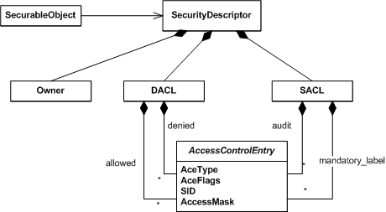
Access control lists
Notes:
Full structure:
http://msdn.microsoft.com/en-us/library/aa379561(VS.85).aspx

Slide 24
Access control lists
Windows object
E.g. file, registry key, pipe…
Notes:
Securable Objects
http://msdn.microsoft.com/en-us/library/aa379557(VS.85).aspx

Slide 25
Access control lists
High level structure

Slide 26
Access control lists
Can change the object’s permissions even if no access is defined

Slide 27
Access control lists
Discretionary Access Control List
Access control

Slide 28
Access control lists
System Access Control List
Security auditing

Slide 29
Access control lists
Type
  allow, deny, audit
Flag
  E.g. inheritance
SID
  who to apply
Mask
  execute | delete | write owner…
Notes:
ACCESS_MASK Data Type
http://msdn.microsoft.com/en-us/library/aa374892(VS.85).aspx

Slide 30
Access control lists - Example
Object C:\temp
Descriptor
Owner: Administrator
DACL
ACE1: allow, inherits, Administrators, list folders | create files
ACE2: allow, not inherited, Users, list folders | read attributes
SACL

Slide 31
Access control lists
Inheritance flag
  For container type objects (e.g. folder)
  Child object inherits the ACE
Evaluation method
  Several ACE can apply to a given SID
  UNION of all the permission from the ACEs
  Exception: deny ACE, it overcomes everything

Slide 32
DEMO
Authorization –
Access control lists
Basic permissions
Inheritance
  Limiting inheritance
Take ownership
Effective permissions
  Union, except
  Deny ACE
Debugging: Process Monitor

Slide 33
Security tasks in Windows
Authentication
  Has / Knows / Is
  E.g. logon screen, password popup
Authorization
  Principle: Role based access control
  E.g. access control lists
Auditing
  Audit logging

Slide 34
Eventlog
System, application, security events
Event:
  Type, time, source, ID, description
Overwrite events:
  Never, x day older, circular

Slide 35
DEMO
Auditing
Auditing policy
Content of the security log
Use of permissions
Notes:
E.g. „Manage auditing and security log (SeSecurityPrivilege): Allows a user to specify object access auditing options for individual resources such as files, Active Directory objects, and registry keys. Object access auditing is not actually performed unless you have enabled it in Audit Policy (under Security Settings , Local Policies ). A user who has this privilege also can view and clear the security log from Event Viewer.
By default, this privilege is assigned to Administrators.”

Slide 36
DEMO
User Account Control, Runas
Dangers of running as Administrator
Working limited user
  Windows XP: Run as… and runas command
  Showing Run as..: left SHIFT + right click
Vista solution: UAC

Slide 37
DEMO
Group Policy
Computer settings
  Security options
  System componets, e.g. Windows Update
User settings
  Applications
  Windows interface
Templates
Administrative templates
~2500 settings
Notes:
Group Policy Settings Reference Windows Vista (http://www.microsoft.com/downloads/details.aspx?FamilyID=41dc179b-3328-4350-ade1-c0d9289f09ef&DisplayLang=en): XLS táblázat az összes csoportházirend beállítási opcióról

Slide 38
Troubleshooting

Slide 39
DEMO
Blue Screen of Death (BSOD)
If there is no other choice…
Don’t hate the messenger☺
KeBugCheckEx function, Bugcheck.h
Error reporting
Creating memory dump
Analyzing minidump in WinDgb

Slide 40
DEMO
Problem solving
Event log errors:
  Help & Support
  EventID.net
  Knowledge Base articles
Notes:
Pl: Esemény típusa: Hiba
Esemény forrása: W32Time
Esemény kategóriája: Nincs
Esemény azonosítója: 29
Dátum: 2007.05.14.
Idő: 13:02:18
Felhasználó: -
Számítógép: GOLF-53BF670901
Leírás:
Az időszolgáltatás NTP-ügyfele úgy van konfigurálva, hogy egy vagy több forrásból kérdezze le az időt, de egyik forrás sem használható. 59 percig nem történik kísérlet egyik forrás elérésére sem. Az NTP-ügyfélhez nincsen pontos időforrás.
http://support.microsoft.com/kb/830092/en-us
http://www.eventid.net/display.asp?eventid=29&eventno=1524&source=W32Time&phase=1

Slide 41
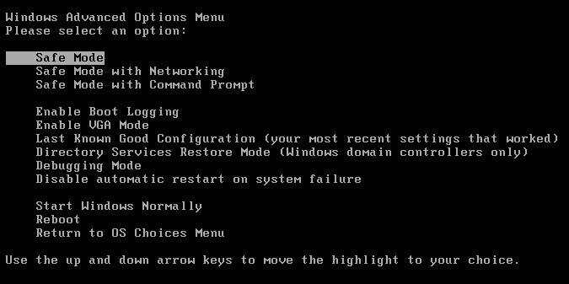
Special startup modes
Hit F8 before the Windows logo
Notes:
A description of the Safe Mode Boot options in Windows XP
http://support.microsoft.com/default.aspx?scid=kb;en-us;315222

