Slide 1
The EU Digital Identity Wallet: Empowering Students Across Europe

Slide 2
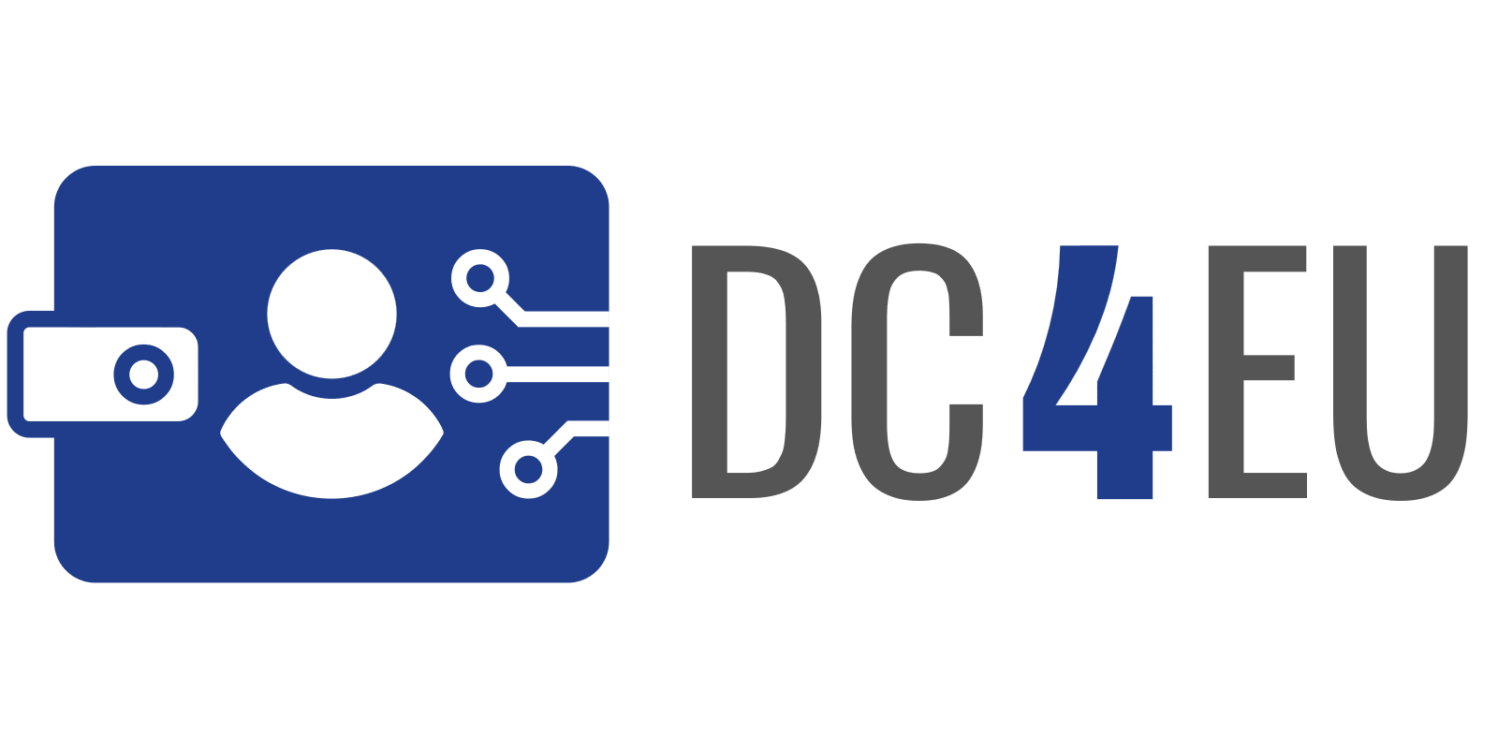
Contents
EU Digital Identity Wallets?
eIDAS2 regulation
How does the wallet work?
Who is involved?
Development
Future outlook
DC4EU Large Scale Pilot
Experience a first version today!

Slide 3
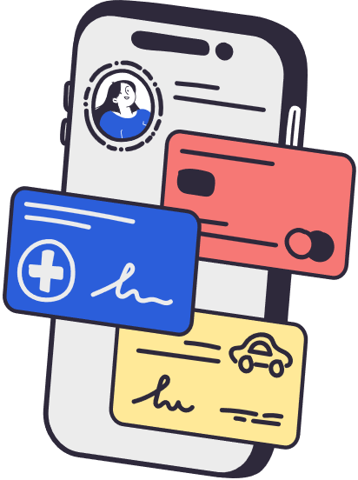
What Are EU Digital Identity Wallets?
They’re a bit like the Google or Apple Wallets that are already on your smartphone, but there are some important differences.
The EUDI Wallet can store official documents such as driving licence, degrees and your health insurance card.
Privacy first; you control your data!

Slide 4
Video introduction

Slide 5
A European Digital Identity Wallet (EUDI Wallet)
A user-centric digital wallet that enables individuals and organisations to store and manage:
Identity attributes (name, birthdate, nationality, etc.).
Electronic Attestations of Attributes - Verifiable credentials (diplomas, professional licenses, social security records).
Authentication methods (eID, qualified electronic signatures and seals).
Legal basis:
Defined under Article 6a of eIDAS 2.
Must comply with high security and privacy standards.
Obligations for Member States:
Each Member State must provide at least one EUDI Wallet.
Wallets must be issued under a notified electronic identification scheme.
Use must be free for natural persons, but business models may apply for legal persons.

Slide 6
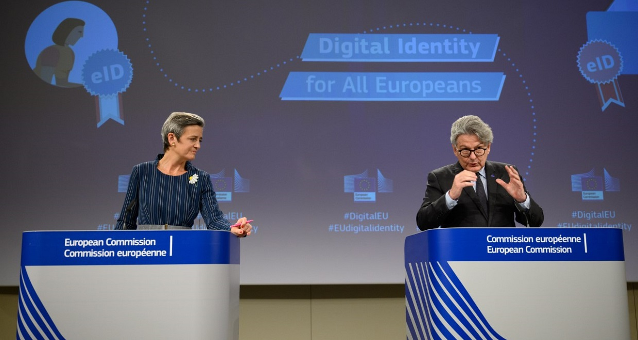
eIDAS2 Framework for Digital ID & Trust Services
eIDAS 2.0 regulation benefits EU citizens by providing easier access to public and private services.
With digital identities and the eIDAS 2.0 wallet, individuals securely authenticate themselves online, reducing the hassle of multiple logins and enhancing privacy.
Enhanced data security and privacy protections are central to eIDAS 2.0. This ensures that personal information is securely managed and shared only with explicit consent, building trust in digital services and encouraging greater participation in the digital economy.

Slide 7
Why eIDAS2 & EUDI?
Privacy by Design: Citizens control their own personal data.
Security: Prevents fraud through strong authentication.
Convenience: Simplifies access to services across Europe.
Interoperability: One standard across all EU member states.

Slide 8
How Does the Wallet Work?
Supports Digital IDs, and official documents such as, drivers licenses, diplomas, etc.
Authentication,
Storing credentials,
Sharing credentials,
and Signing official documents.
One European Standard supports multiple wallet providers.

Slide 9
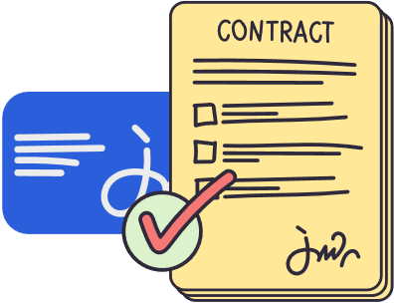
Example Use Cases
Enrolling in educational institutions.
Accessing government services.
Opening bank accounts.
Travel documentation.
Signing official documents.

Slide 10
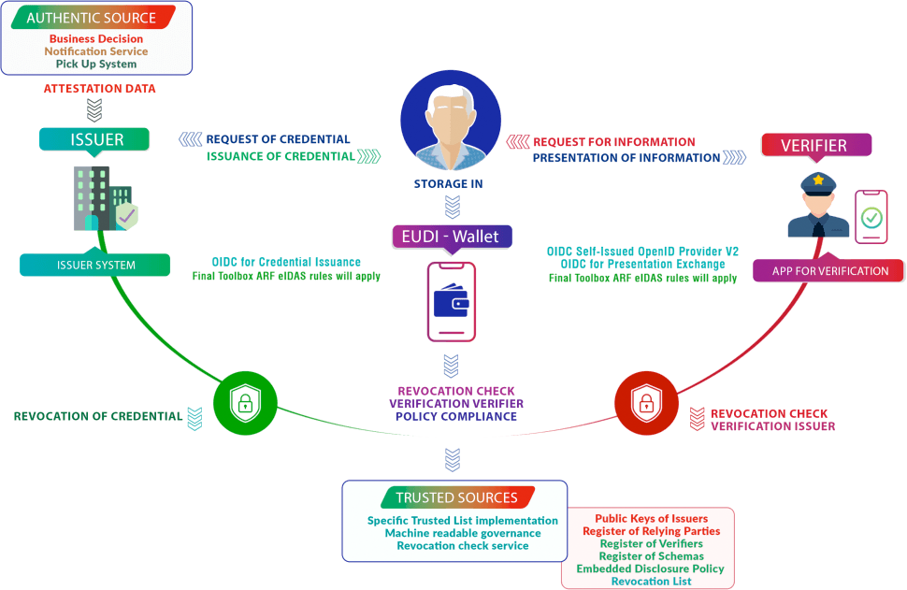
Credential sharing

Slide 11
Security and Privacy
User consent for data sharing
Selective disclosure
End-to-end encryption
Digitally verified
Compliance with GDPR and eIDAS

Slide 12
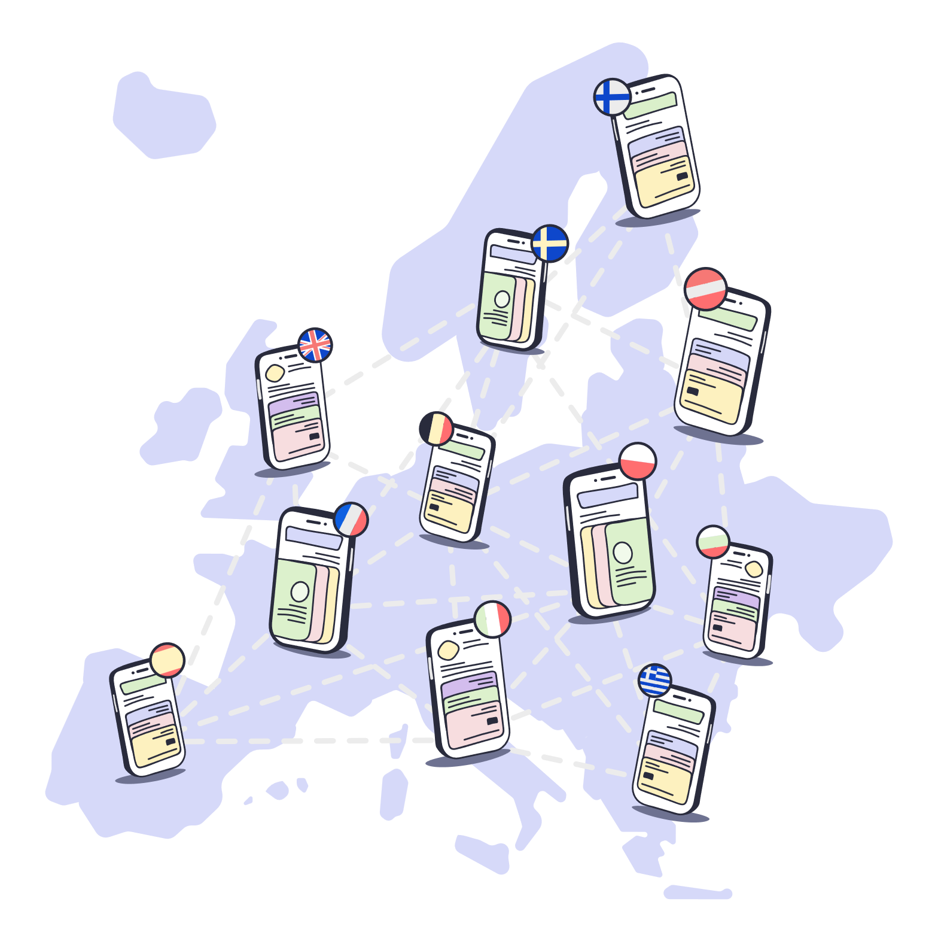
Who Is Involved?
All EU Member States
Issuers of Digital Documents, such as Universities and, government agencies
Wallet Providers
Verifiers, such as Universities, employers and service providers.

Slide 13
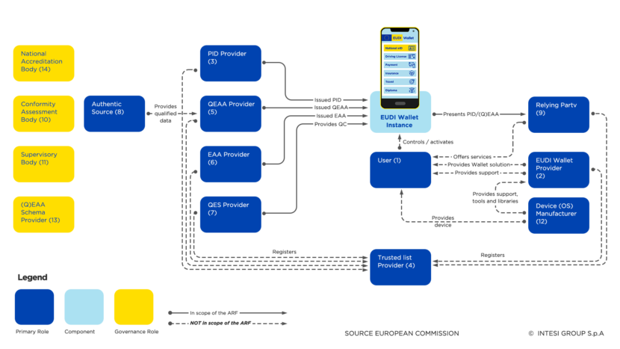
Development
Architecture and Reference Framework (ARF): defines common standards.
Four Large Scale Pilots, testing various use cases:
Travel
Banking
Health care
Education
Etc.
https://github.com/eu-digital-identity-wallet/eudi-doc-architecture-and-reference-framework

Slide 14
DC4EU
EU funded Large Scale Pilot, involving 25 countries and close to 100 organisations.
Social Security
Education
Develop and Pilot the EUDI Wallet

Slide 15
Future Outlook
Full adoption across all EU member states in 2026
Integration with non-EU digital identity systems
Continuous updates for better user experience and enhanced security

Slide 16
Experience a first version!
Use case: International Student Exchange.
Finally, no more paperwork, reducing errors and delays.
Share your PID & Educational credentials with institutions across Europe, for enrollment or recognition.
Report your findings to the European Commission.

Slide 17
How to participate
Fill out and sign the Consent Form
Send it using your *.edu.bme.hu email to martin.farkas@edu.bme.hu with subject DC4EU onboarding
Join us at the issuance party, with free pizza🍕 we will provide the date and details later

